Slide 1


Slide 2
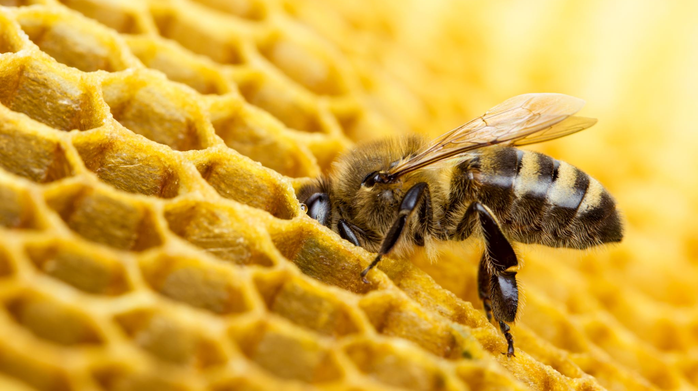
ARTIFICIAL INTELLIGENCE BEE COLONY AND AI BAT ALGORTHIM
PRESENTED BY
HUZAIFA SHAHBAZ
21-CE-009
PRESENTED TO
MAAM KAYYNAT RANA

Slide 3
OUTLINES
INTRODUCTION
HISTORY
WORKING AND CONSTRUCTION
MATHEMATICAL DERIVATIONS
USES AND APPLICATIONS
CONCLUSIONS
REFERENCES

Slide 4
INTRODUCTION
Artificial Intelligence Bee colony A computational method that resembles the intelligent foraging behavior of honeybee colonies
Swarm Intelligence The collective behavior of decentralized, self-organized systems
Biomimicry in AI The process of learning from nature’s millions of years of evolutionary optimization
Why Bees? The complexity of their communication, role specialization and efficient resources allocation make them ideal models for optimization algorithms
Bat algorithm is a metaheuristic optimization algorithms inspired by the echolocation behavior of microbats
Echolocation is a process where bats emit sound pulses and listen to echoes to navigate and find prey
Key characteristics
Population-based search algorithm
Combines global exploration and local exploitation

Slide 5
HISTORY
1990s The concept of early swarm intelligence has been gaining traction
2005 Dervis Karaboga’s Artificial intelligence bee colony algorithm is a proposed method for creating artificial colonies
2006-2010 The process of refinement and applications of optimization problems
Key Contributors
Dervis Karaboga
Bahriye Akay
Pinar Civicioglu
Evolution The integration of bee colony principles with other AI approaches is being explored in various models and hybrid algorithms
Evolution
2010 Basic Bat Algorithm introduced
2011 Multi-objective bat algorithm developed
2012-2014 Various modifications and hybrid versions proposed
2015-Present Advanced variants including binary, chaotic, and fuzzy bat algorithms
Notes:
Traction means the measurable progress or momentum a company or project is gaining, including acquiring users, increasing revenue, or achieving milestones, indicating that the product or service resonates with its target audience and is finding acceptance.
Dervis Karaboga received the B.Sc. degree from the Department of Electronic Engineering Erciyes University, Kayseri, Turkey, in 1983, the M.Sc. degree in electronics and communications engineering from the Technical University of Istanbul, Istanbul, Turkey, in 1988, and the Ph.D. degree from Systems Engineering Department, University of Wales, College of Cardiff, Cardiff, U.K., in 1994.
Bahriye Akay received the B.Sc., M.Sc., and Ph.D. degrees in computer engineering from Erciyes University, Türkiye, in 2003, 2005, and 2009, respectively, and the Postdoctoral degree from the University of Birmingham, U.K., in 2011. She is currently a Professor with the Department of Computer Engineering, Erciyes University. She was selected as a Highly Cited Researcher by Clarivate Analytics, in 2018. Her research interests include artificial intelligence, evolutionary computation, swarm intelligence techniques, and software engineering.
Prof. Dr. Pınar Çivicioğlu Beşdok is a distinguished academic in the field of computer science, specializing in artificial intelligence and computational intelligence. She completed her Bachelor of Engineering, Master's, and Ph.D. degrees at Erciyes University in Kayseri, Turkey, in 1997, 2000, and 2004, respectively.

Slide 6
WORKING AND CONSTRUCTIONS
Algorithm fundamentals
Bee roles
Employed bees Is to exploit the existing food sources
Onlooker bees Select food sources based on their quality
Scout bees To exploring new solutions
Algorithm Structure
Population of virtual "bats" (candidate solutions)
Each bat has position, velocity, frequency, loudness, and pulse rate
Bats "fly" through solution space searching for best prey (optimal solution)
Search Process
Global exploration (low pulse rate)
Local exploitation (high pulse rate)
Automatic balancing between the two modes

Slide 7
MATHEMATICAL DERIVATIONS
Objective Function The measure focuses on evaluating the quality of food sources
Position Update Formula
v_{ij} = x_{ij} + φ_{ij}(x_{ij} - x_{kj})
Where
v_{ij} = New candidate solution.
x_{ij} = Current solution.
ϕ_{ij}​ = Random number in [-1,1].
x_{kj}​ = Another solution for diversity.
Probability Selection
p_i = fitness_i / Σ fitness_n
Limit parameter Controls when to abandon solutions

Slide 8
MATHEMATICAL DERIVATIONS
Mathematical Derivations - Advanced Mechanisms
Local Search
x_new = x_old + εA^t
here: ε is a random number in range [-1,1]
A^t is the average loudness of all bats at time t
Loudness Update
A_i^{t+1} = αA_i^t
Where α is a constant (0 < α < 1)
Pulse Rate Update
r_i^{t+1} = r_i^0[1-exp(-γt)]
Where: r_i^0 is the initial pulse rate
γ is a constant

Slide 9
USES AND APPLICATIONS
Industry Applications
Production Scheduling
Transportation Routing
Power Grid Optimization
Emerging Fields
Medical Image Processing
Renewable Energy Management
Smart City Planning
Specialized Applications
Continuous Optimization Problems
Function optimization
Constrained optimization
Multi-objective optimization
Engineering Design: Structural optimization
Mechanical design
Parameter estimation

Slide 10
Conclusion
Simple concepts, easy implementation, effective for complex optimization
Limitations is parameter sensitivity, potential local optima trapping
Impact bridges natural system and computational intelligence, providing efficient solutions to complex problems

Slide 11
REFERENCES
Karaboga, D. (2005). "An idea based on honeybee swarm for numerical optimization." Technical Report TR06, Erciyes University.
Karaboga, D., & Basturk, B. (2007). "A powerful and efficient algorithm for numerical function optimization: Artificial Bee Colony (ABC) algorithm." Journal of Global Optimization.
Karaboga, D., & Akay, B. (2009). "A comparative study of Artificial Bee Colony algorithm." Applied Mathematics and Computation.
Akay, B., & Karaboga, D. (2015). "A survey on the applications of artificial bee colony in signal, image, and video processing." Signal, Image and Video Processing.

